Slide 1
IVR File Processing
Krishna Prasad Mupparaju

Slide 2
Application Details
The Application has been implemented in two parts.
Client (Consumer) App: IVRClientApp
Receives the Wave file from user, converts it into mp3 format and send the same to Restful Service.
Fetch the file details from Restful Service and displays to the end user.
Restful Web Service (Producer): IVRRestFulService
Receives mp3 file and stores it in local drive.
Provides the details based on the given file name.

Slide 3
Technology Stack
The list of technologies used:
FTL (Free Marker Language): View pages
JAVE (Java Audio Video Encoder): To convert WAV file to MP3
JDK 1.8: To Provide Java environment
Apache Tomcat: Web Server
Jaudiotagger: To get audio length
Gradle: Build Tool
RestTemplate: To communicate with Restful web service
CSS: For Styles

Slide 4
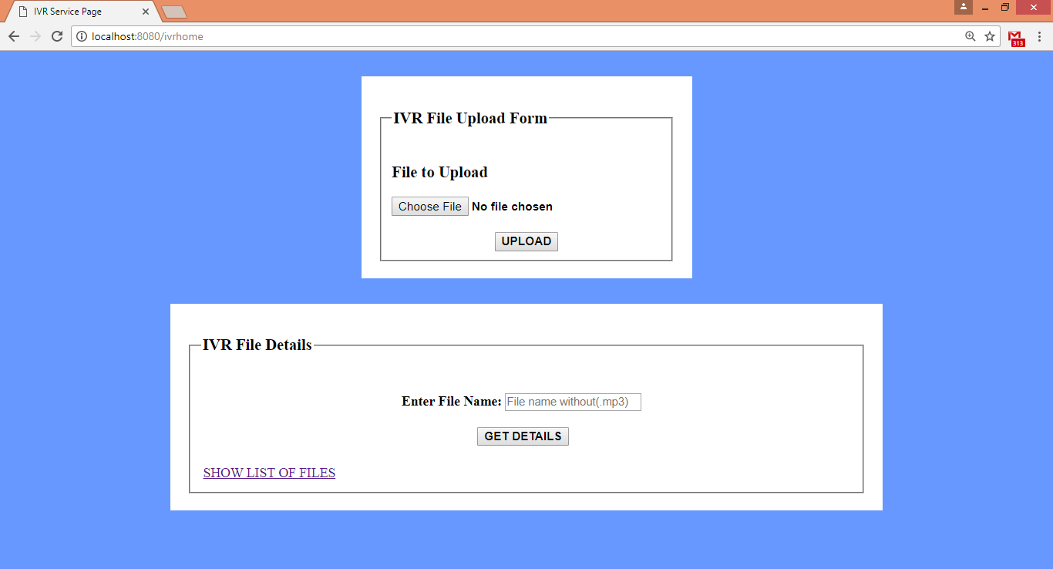
Application Interface (http://localhost:8080/ivrhome)

Slide 5
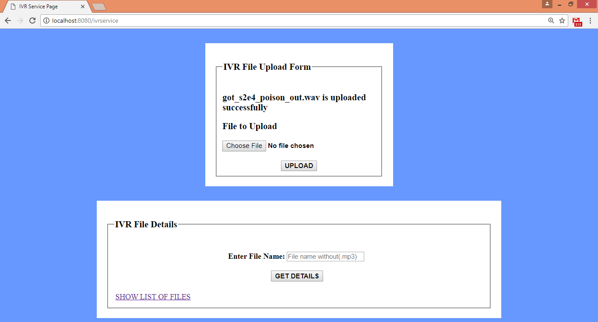
File Upload Interface – Post method (http://localhost:8080/ivrservice)

Slide 6
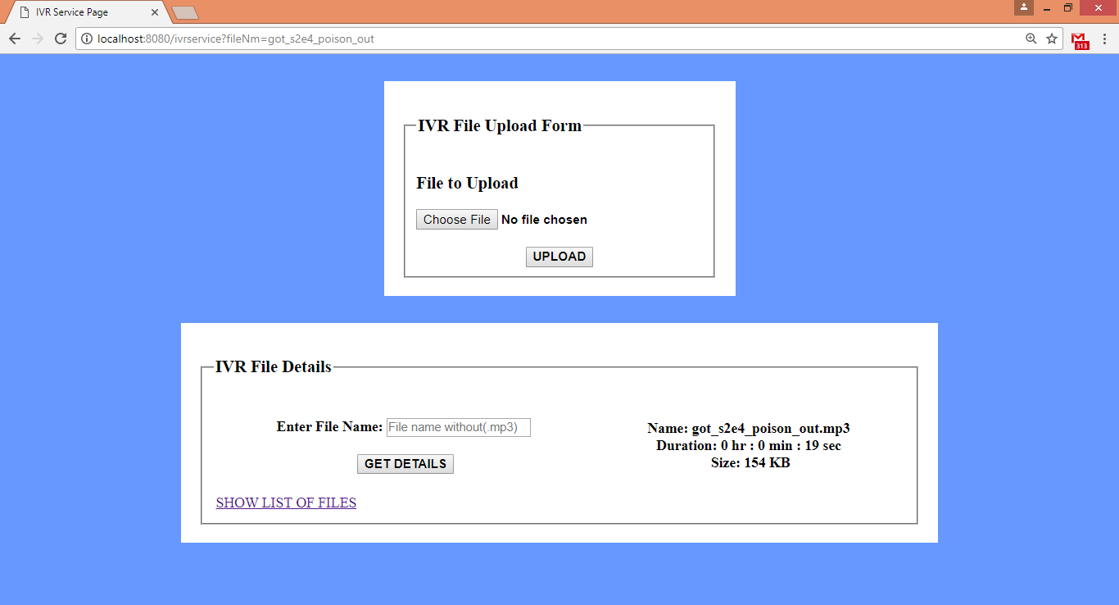
File Details Interface – Get method (http://localhost:8080/ivrservice?fileNm=got_s2e4_poison_out)

Slide 7
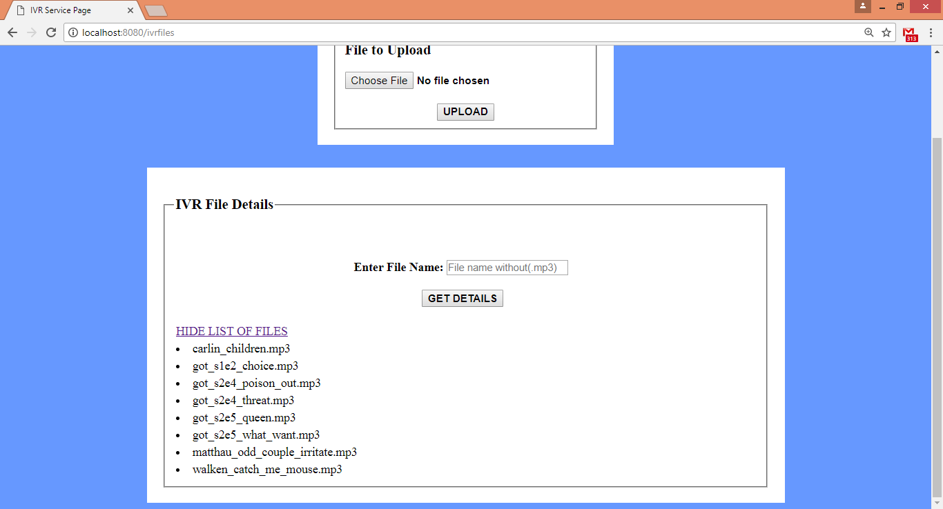
Files List Interface – Get method (http://localhost:8080/ivrfiles)

Slide 8
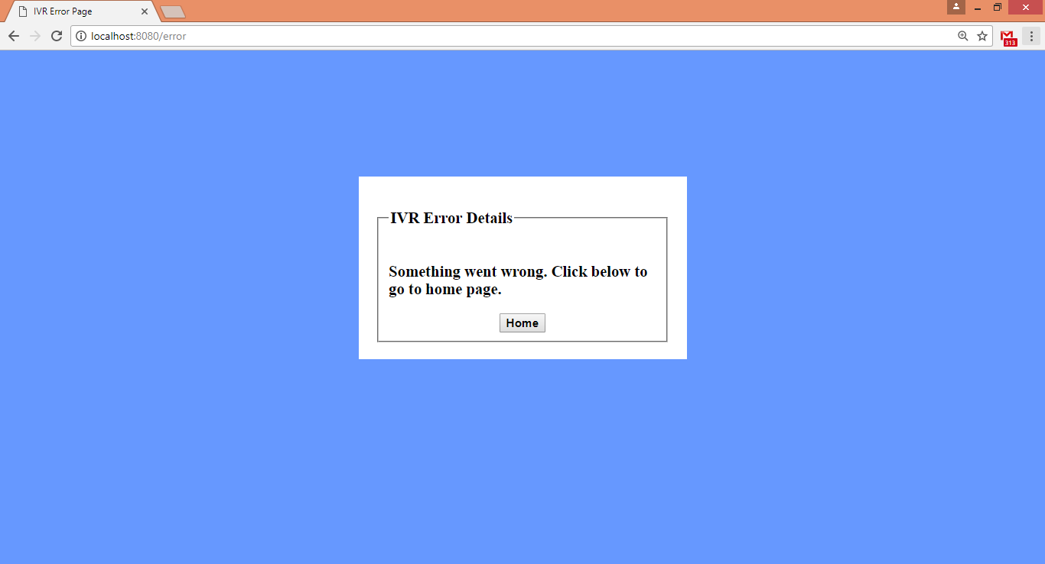
Error Handling Interface (Controller Advise)

Slide 9
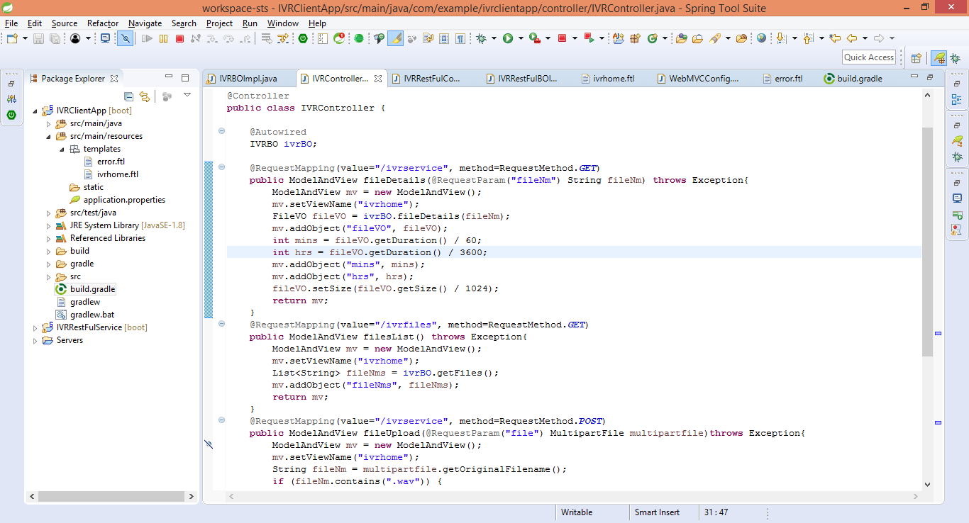
Client App Controller API’s

Slide 10
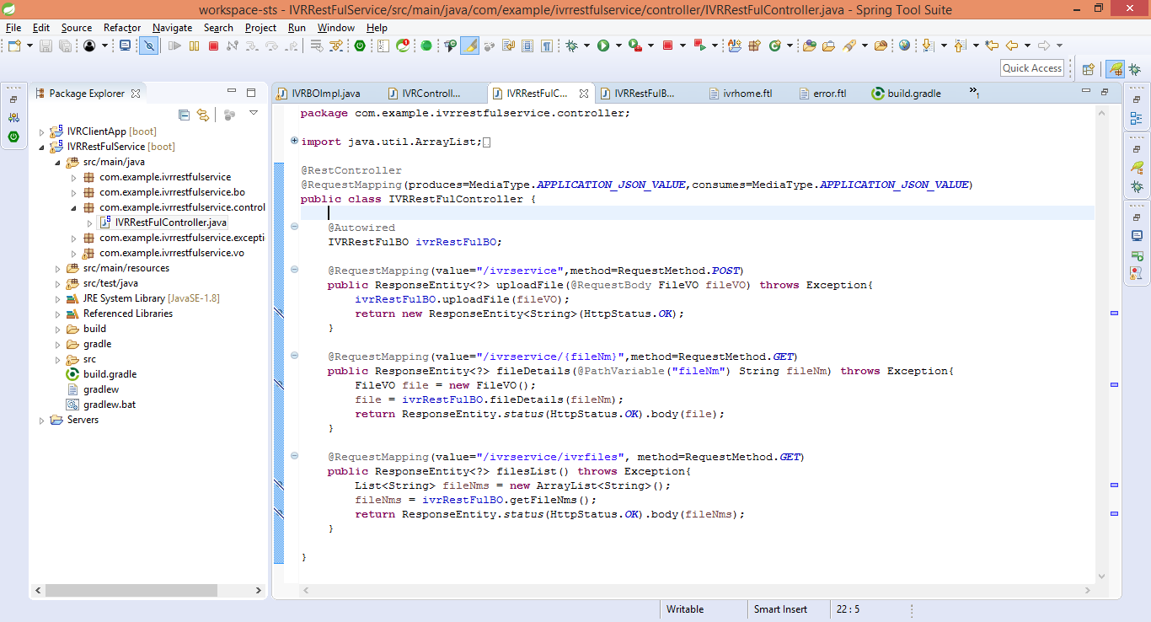
Restful Web Service API’s

Slide 11
Project in Github
The Source code is available in github at following path:
IVRClientApp: https://github.com/kmuppara/IVRClientAPP.git
IVRRestFulService: https://github.com/kmuppara/IVRRestFulService.git

Slide 12
Thank You
Krishna Prasad Mupparaju

